Slide 1
Timetables and timezones
How do I solve problems using CUBES strategy in OLNA?

Slide 2

Cubes Strategy

Slide 3
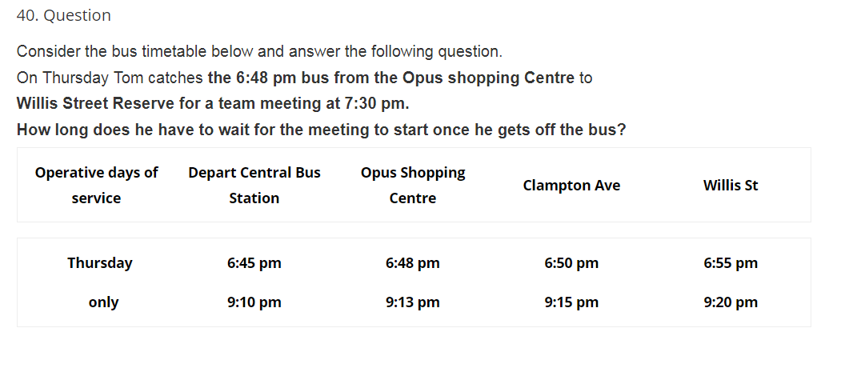
timetables

Slide 4
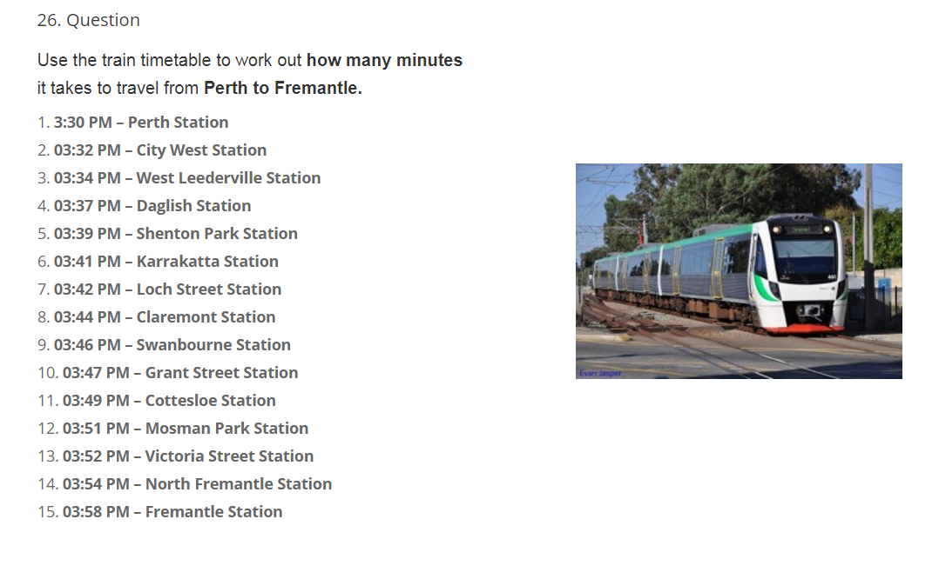

Slide 5
Practise time
Lets have a go at some questions on a worksheet.
Remember to read the question carefully and use the CUBES strategy.

Slide 6
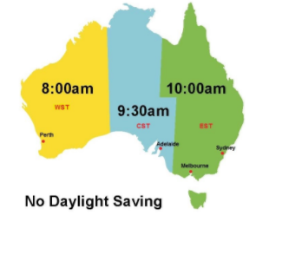
Timezones
Draw NZ on your map. What is the time there?

Slide 7

Questions

Slide 8
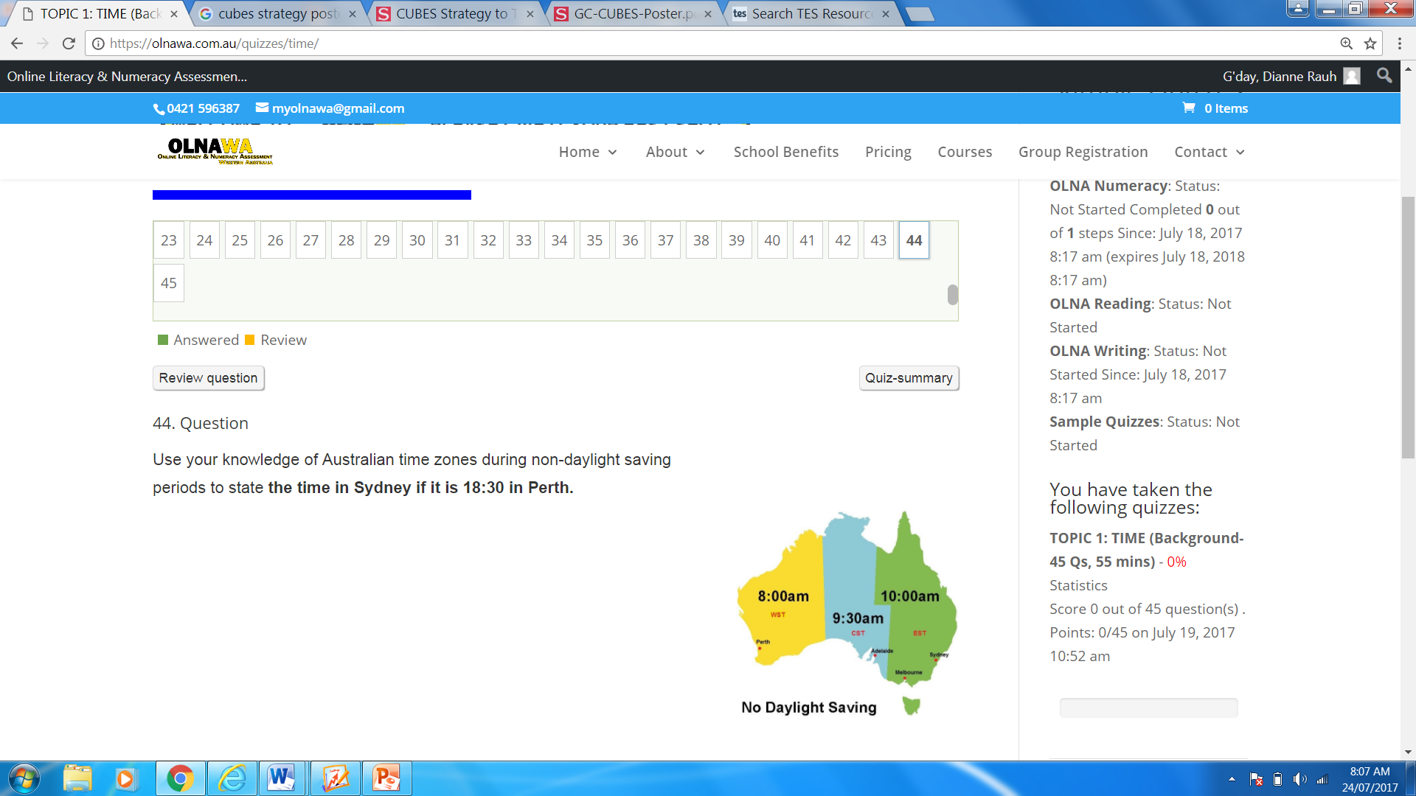

Slide 9
Bit of practise
Page 194 of Dwyer 8

Slide 10
Learning Log
That is the end of the unit on time.
In pairs please complete your learning log.
These learning logs will be used as 50% of your AVID mark for term 3.
Be prepared to share some points on your learning log with another pair and then the whole class.

